Slide 1
GYMIC Linux Anomaly Detection
Students:
Amir Mizrahi | Inon Weber | Or Chechik
Yonatan Glozman | Yosef Yaakov
Supervisor:
Dr. Nezer Zeindberg

Slide 2
The Problem:
Most of endpoint security products target Windows systems
Threats become more sophisticated and harmful
Attackers are using advanced exploitation methods (ROP)
Users are suffering from high CPU utilization (Crypto miners)
Malware are using high-level hiding techniques (Rootkits)
Security experts lack of the full picture of the threats in their organizations (Mostly AV / SIEM alerts).

Slide 3
The Solution:
Linux dedicated agents, collecting real-time data
Both user & kernel mode inspection for full coverage
Data analysis for anomaly detection
Automatic response provides additional artifacts extraction
Data and insights visualization for further investigation

Slide 4







Architecture Overview:
UI (Kibana)
Analytics, Big Data & Storage (Analytics Server + Elasticsearch)
Automatic response & advanced artifacts extraction
Visualization & further investigation
Data analyzed for anomaly detection
Data collected from Linux agents

Slide 5

Architecture - Endpoint:
Kernel Mode
Processes
Threads
Modules
User Mode
Kernel Mode
Kernel Mode
Processes
Threads
Modules
User Mode
Processes
Threads
Modules
Network
Analytics, Big Data & Storage (Analytics Server + Elasticsearch)
User Mode
Processes
Threads
Modules
Network
Kernel Mode
Processes
Threads
Modules
Kernel data sent to user app via Netlink
All information sent periodicly to the server for analysis
Hiding ability

Slide 6
Analytics:
User & kernel mode artifacts comparison
1
User Mode
Processes
Threads
Modules
Kernel Mode
Processes
Threads
Modules
ROP exploitation detection in memory evidence
3
Stack Pivot
Return Oriented Payload Stage
Traditional Payload
Permanent DEP Bypass Exploit
2
Crypto miners detection
Processes CPU Usage
ML Model
Potential Miner

Slide 7
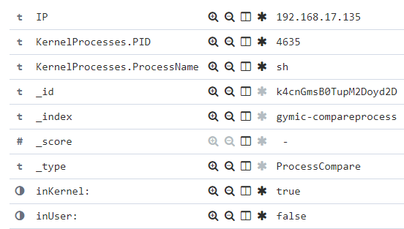
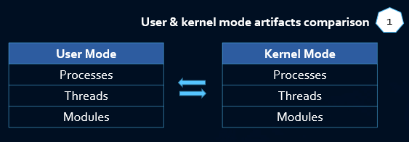
User & kernel mode artifacts comparison:
Compare the output of same artifacts from user and kernel space
Automatic response is triggered if any differences found

Slide 8
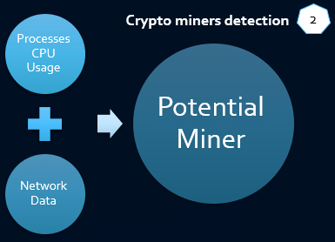

Crypto miners detection:
Trained KNN model of more than 9000 processes
Analysis based on process names, users, network and CPU usage
Prediction of new processes based on trained data

Slide 9
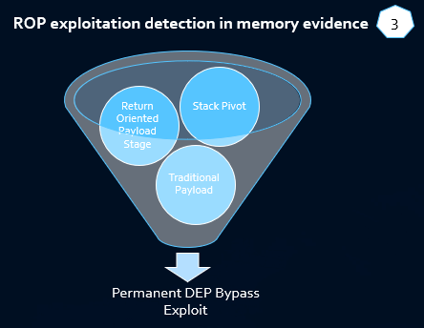
ROP exploitation detection in memory evidence:
ROP – Return Oriented Programming – exploitation method to bypass DEP
A Volatility plugin - detects ROP gadgets in Linux physical memory dumps
Tested on a POC vulnerable C code that was exploited to run shellcode using ROP to bypass DEP

Slide 10
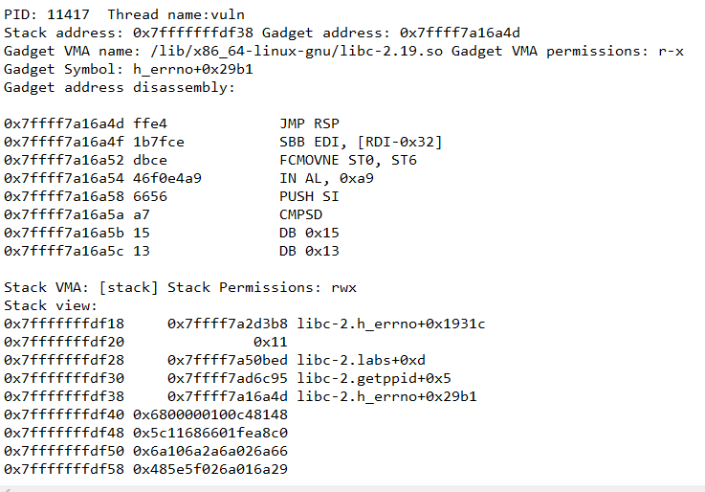
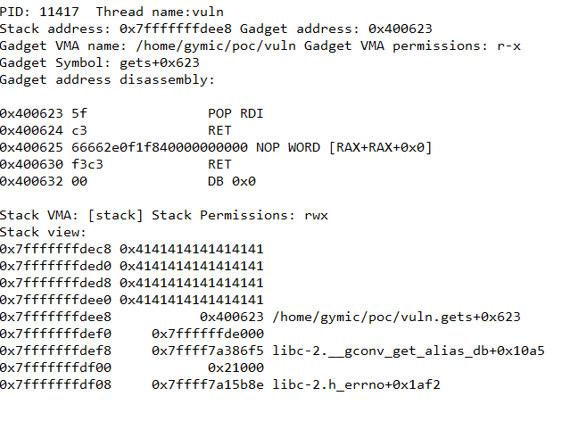
ROP exploitation detection - output:

Slide 11

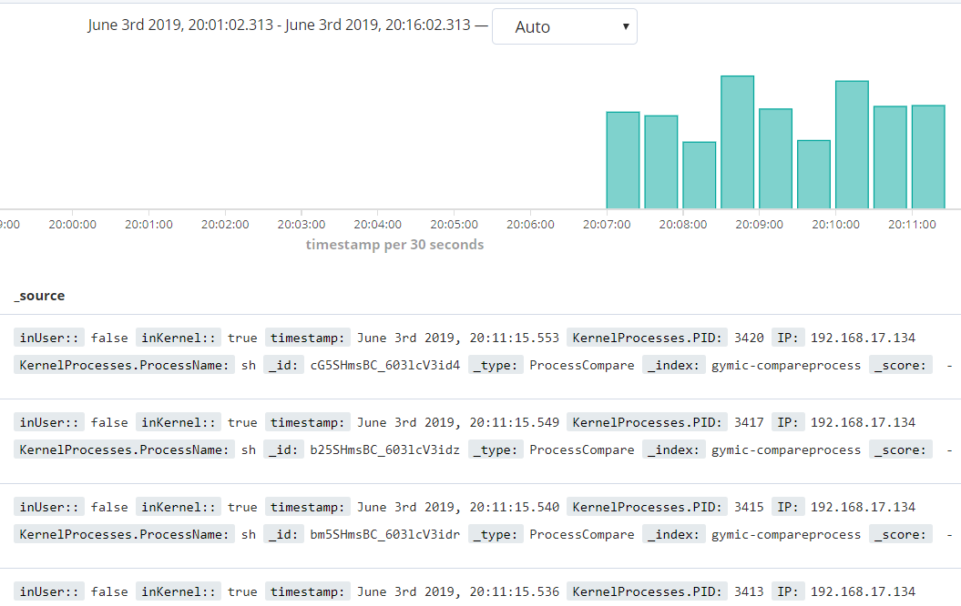
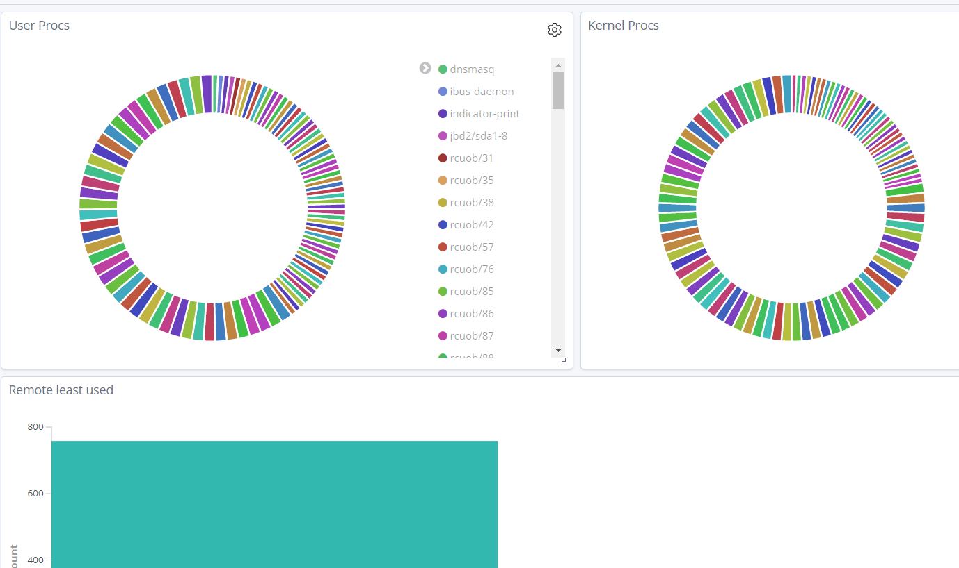
Visualization:

Slide 12
Main Challenges:
No tools \ volatility plugins to detect ROP chains in physical memory, its hard to detect in memory
Overcome by developing our own exploitation code
Developed our own vulnerable code
The need of custom made anomalies for tests
Overcome by searching and testing of various crypto-miners and rootkits, both legitimate and malicious

Slide 13
Execution Example
Questions so far?

Slide 14
פריסת כותרת ותוכן עם תרשים

Slide 15
פריסת שני תכנים עם טבלה
 | קבוצה 1 | קבוצה 2
שיעור 1 | 82 | 95
שיעור 2 | 76 | 88
שיעור 3 | 84 | 90
נקודת התבליט הראשונה כאן
נקודת התבליט השניה כאן
נקודת התבליט השלישית כאן

Slide 16
פריסת כותרת ותוכן עם SmartArt
כותרת שלב 1
תיאור משימה
תיאור משימה
כותרת שלב 2
תיאור משימה
כותרת שלב 3
תיאור משימה
תיאור משימה
תיאור משימה

